Slide 1
Sound Adversarial Audio-Visual Navigation
Yinfeng Yu^{1,3}, Wenbing Huang², Fuchun Sun^{*1},
Changan Chen⁴, Yikai Wang^{1,5}, Xiaohong Liu¹
¹Beijing National Research Center for Information Science and Technology (BNRist),
State Key Lab on Intelligent Technology and Systems,
Department of Computer Science and Technology, Tsinghua University
²Institute for AI Industry Research (AIR), Tsinghua University
³College of Information Science and Engineering, Xinjiang University
⁴UT Austin ⁵ JD Explore Academy, JD.com
∗Corresponding author: Fuchun Sun.

Slide 2
Motivation
SoundSpaces^{[1]} is focus on audio-visual navigation problem in the acoustically clean or simple environment.
However, there are many situations different from the setting of SoundSpaces, which there are some non-target moving sounding objects in the scene:
For example, a kettle in the kitchen beeps to tell the robot that the water is boiling, and the robot in the living room needs to navigate to the kitchen and turnoff the stove; while in the living room, two children are playing a game, chuckling loudly from time to time.
The limitation of SoundSpaces is: it cannot model non-target moving sounding objects.
[1] C. Chen*, U. Jain*, et al., SoundSpaces: Audio-Visual Navigation in 3D Environments, ECCV 2020

Slide 3
Motivation
Challenge 1:
How to model non-target moving sounding objects in a simulator or reality? There is no such setting that existed!
Challenge 2:
Can an agent still find its way to the destination in an acoustically complex environment?
non-target moving sounding objects:
not deliberately embarrassing the robot: someone walking and chatting past the robot
deliberately embarrassing the robot: someone blocking the robot forwarding

Slide 4
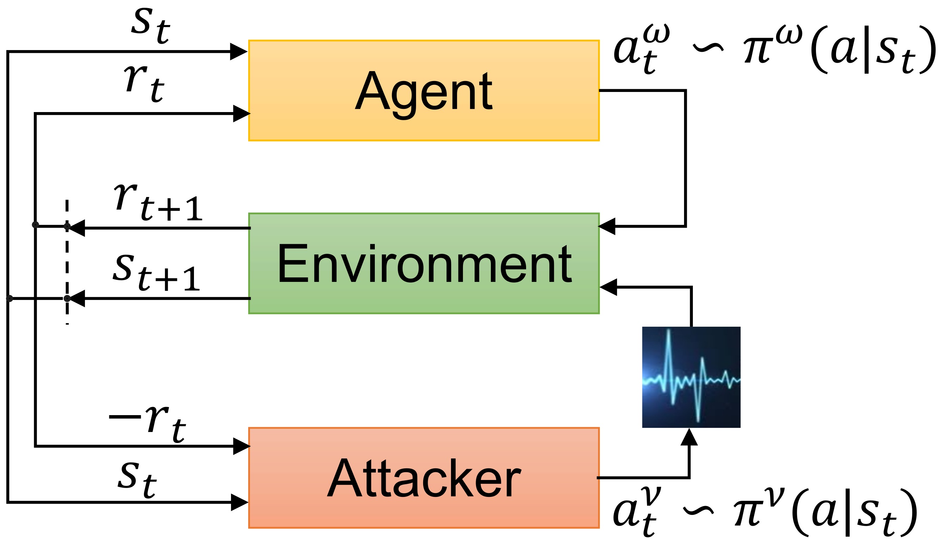
Mathematical model
Worst case strategy: Regard non-target sounding objects as deliberately embarrassing the robot. We called them sound attackers.
Simplify: Only consider the simplest situation, one sound attacker.
Zero-sum game: One agent, one sound attacker.

Slide 5
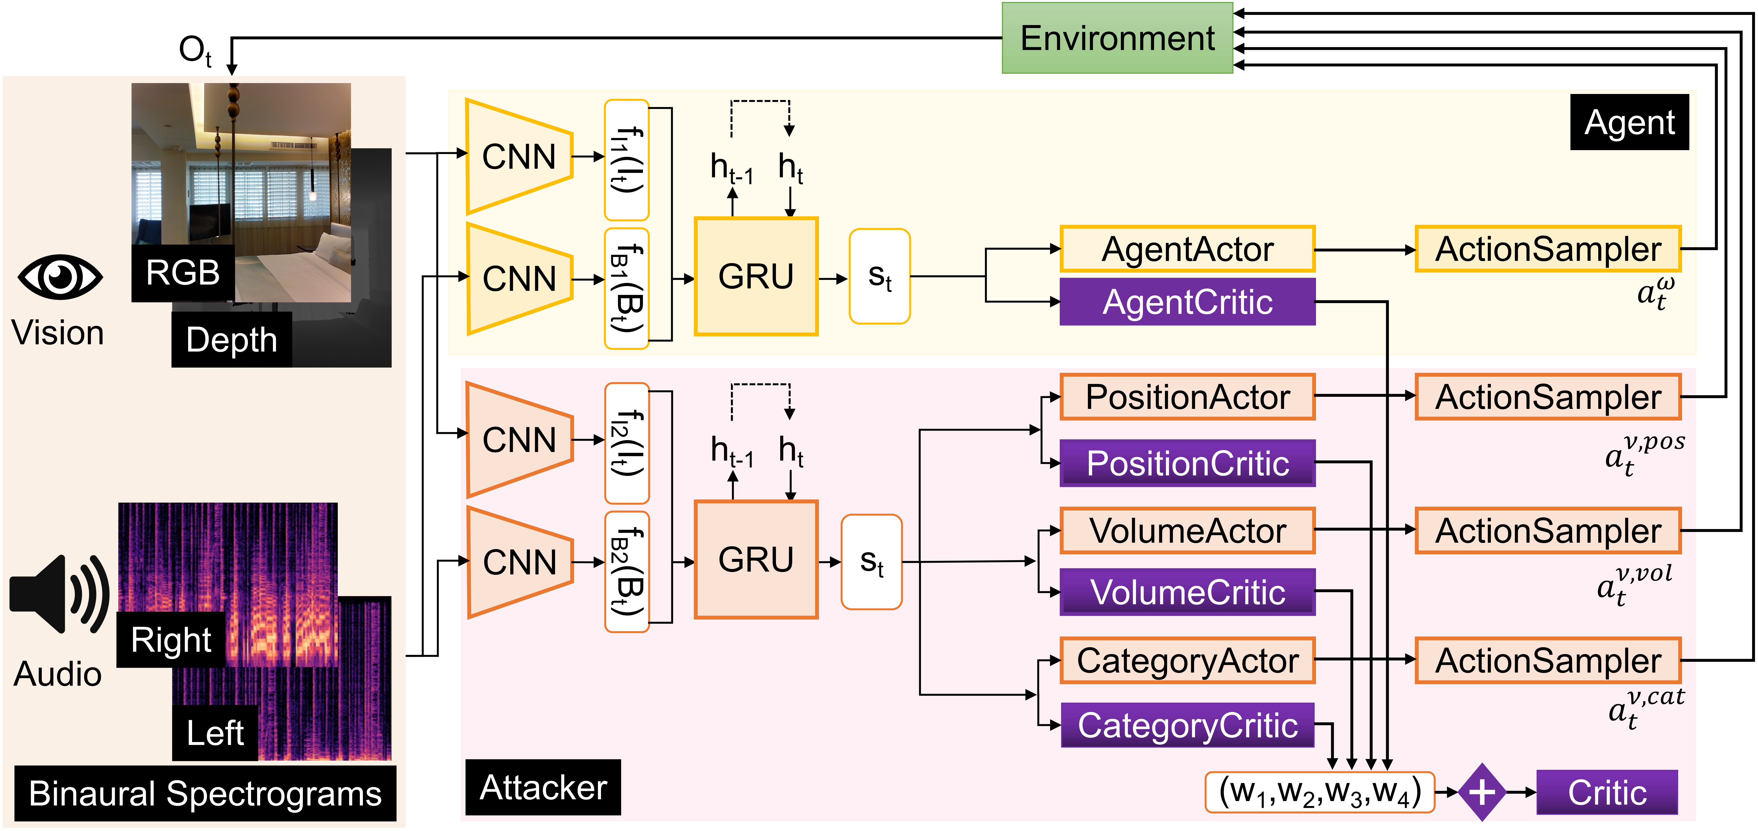
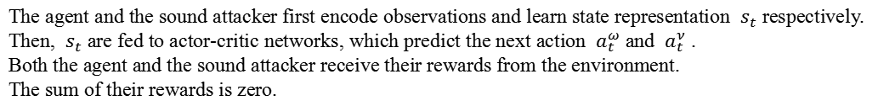
Neural network model
The agent and the sound attacker first encode observations and learn state representation $s_{t}$ respectively.
Then, $s_{t}$ are fed to actor-critic networks, which predict the next action $a_{t}^{ω}$ and $a_{t}^{ν}$ . Both the agent and the sound attacker receive their rewards from the environment. The sum of their rewards is zero.

Slide 6
Experiment Setup
Baselines:
Random: A random policy that uniformly samples one of three actions.
AVN^{[1]}: An audiovisual embodied navigation trained in an environment without sound intervention.
SA-MDP^{[2]}: We adopt its idea but only intervene state of the sound input and do not process the visual information.
Metrics :
SPL: Success weighted by Path Length
R_{mean}: stands for average episode reward of agent
SSPL: Soft Success weighted by Path Length
SR: Success Rate
DTG: average Distance To Goal
NDTG: Normalized average Distance To Goal
[1] C. Chen*, U. Jain*, et al., SoundSpaces: Audio-Visual Navigation in 3D Environments, ECCV 2020
[2] H. Zhang, H. Chen, et al., Robust deep reinforcement learning against adversarial perturbations on state observations, NeurIPS 2020

Slide 7
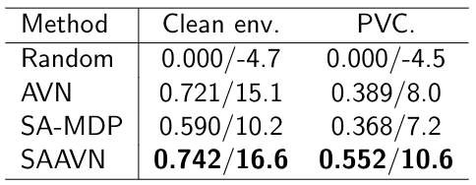
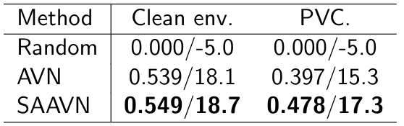
Experiment Results
Performance comparison of different models on Replica.
an acoustically
complex environment
Performance comparison of different models on Matterport3D.
Comparison of different models under SPL (↑)/R_{mean} (↑) metrics.

Slide 8
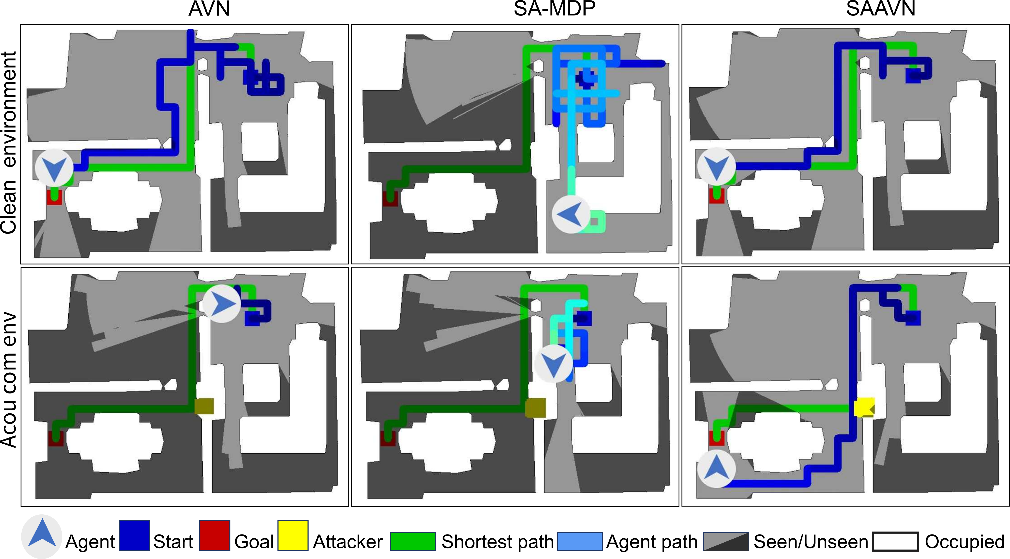
Navigation Trajectories
AVN: can complete the task in a clean environment but fails in an acoustically complex environment.
SA-MDP: was unable to complete the job successfully in all two settings.
SAAVN (ours): reaches the goal most efficiently.

Slide 9
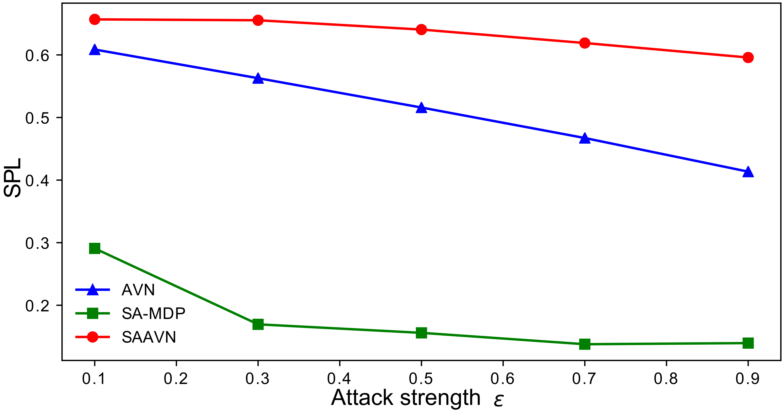
Robustness
Our method’s performance decreases more slowly, which fully demonstrates that our approach helps improve the robust performance of the algorithm.

Slide 10
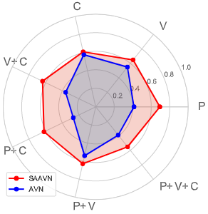
Ablation study for the attack policy regarding the position, sound volume, and sound category
The performance of our method is better than AVN in all acoustically complex environments.

Slide 11
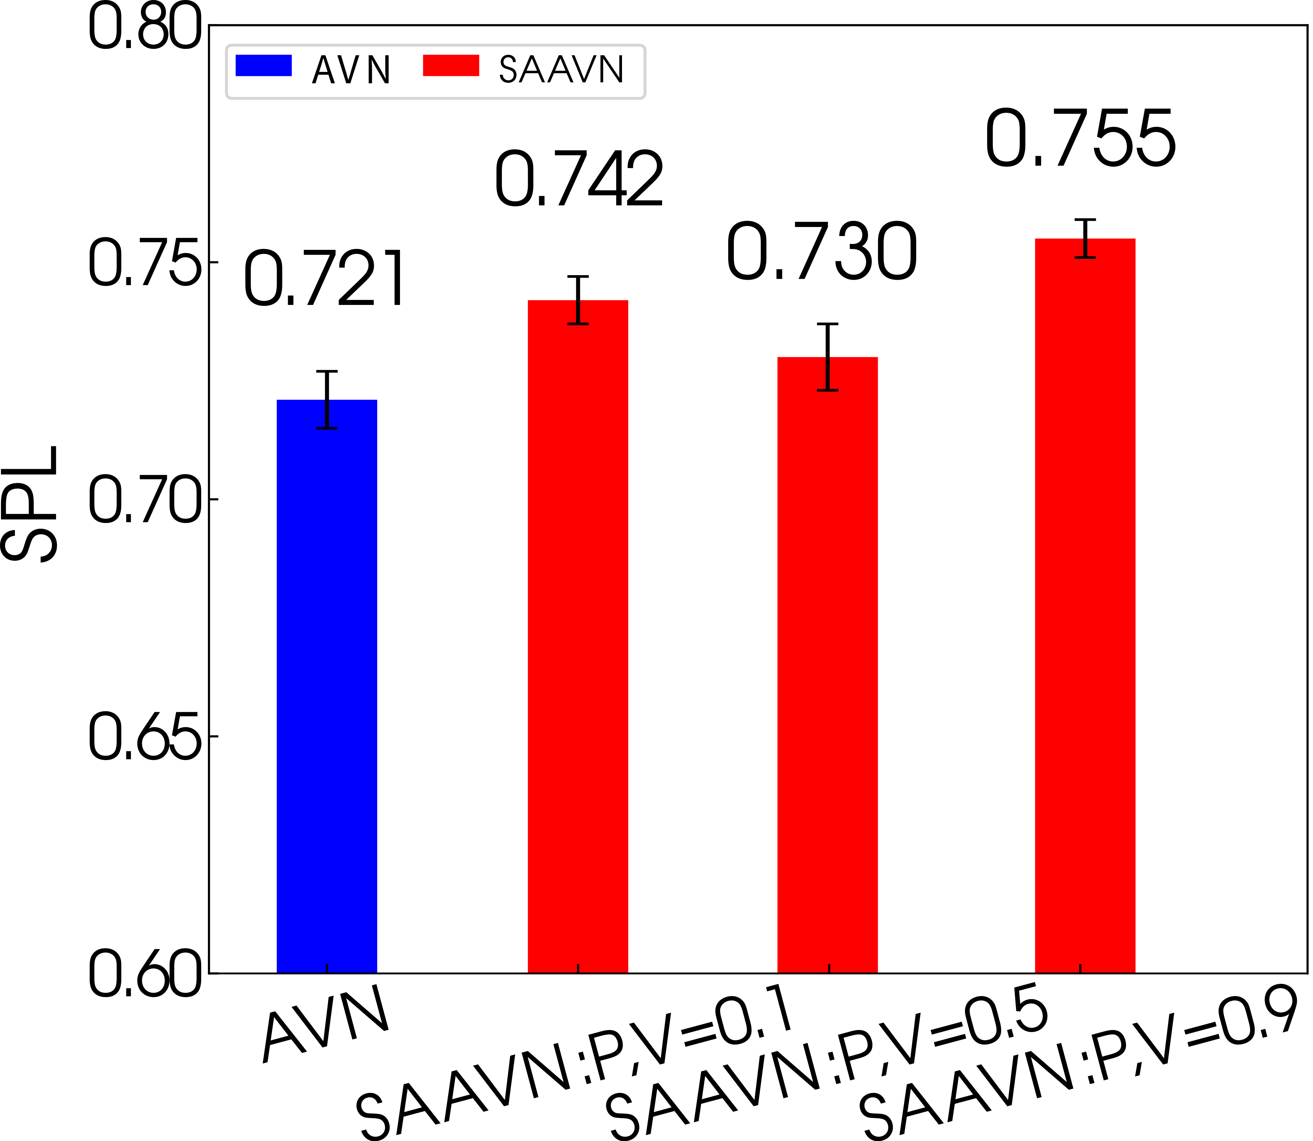
Is the louder the sound attacker's volume, the better?
The relationship between the navigation capacity and the volume of the sound attacker is not straightforward. It depends on other factors, including the position and sound category.

Slide 12
Conclusion
This paper proposes a game where an agent competes with a sound attacker in an acoustical intervention environment.
We have designed various games of different complexity levels by changing the attack policy regarding the position, sound volume, and sound category.
Interestingly, we find that the policy of an agent trained in acoustically complex environments can still perform promisingly in acoustically simple settings, but not vice versa.
We rationally model the gap between audiovisual navigation research and its practical application.
A complete set of ablation studies is also carried out to verify the optimal choice of our model design and training algorithm.
For more details, please refer to the original paper.

Slide 13

Sound Adversarial Audio-Visual Navigation
Yinfeng Yu^{1,3}, Wenbing Huang², Fuchun Sun^{*1},
Changan Chen⁴, Yikai Wang^{1,5}, Xiaohong Liu¹
The project and code can be viewed at the following website:
https://yyf17.github.io/SAAVN

